Slide 1
Third Review on
AI-Powered Virtual Garment Trial Room using Augmented Reality (AR)
By
Nallagatla Vignesh

Slide 2
Contents
Title justification
Abstract
Existing system and its disadvantages
Proposed system and its advantages
Software requirements
Hardware requirements.
Literature review
Literature search
Problem Statement
Identification of Essential concepts/Equipment/Components/Tools
Effective Utilization of Modern Tools and Design
Design Strategy
UML Diagrams
Analysis of Results
Sample output
Challenges & Future Improvements

Slide 3
Title Justification
"AI-Powered Virtual Garment Trial Room using Augmented reality (AR) " allows users to try on clothes digitally using AI, just like a fitting room but online. It enhances convenience, reduces returns, improves the shopping experience, helps businesses boost customer engagement, and saves time for both customers and retailers.

Slide 4
Abstract
The AI-Powered Virtual Garment Trial Room using Augmented reality (AR) is an innovative solution designed to enhance the online shopping experience by enabling users to virtually try on apparel and accessories. The project addresses a major limitation of e-commerce: the inability to physically try products before purchase. Using augmented reality (AR) technology and advanced image processing, the system captures the user’s image via a webcam and superimposes selected garments and accessories onto their body in real-time.
The system leverages Haar cascade datasets for body and face detection and convolutional neural networks (CNNs) for accurate alignment of apparel. The Flask framework integrates the back-end Python scripts with an interactive HTML front-end, allowing seamless user interaction. Users can register, shop, and virtually try on items, while administrators can manage the product catalog through an intuitive interface.
This cost-effective solution eliminates the need for expensive hardware, relying instead on efficient software tools like OpenCV and Dlib. Future enhancements include the integration of advanced networks, such as Pose Alignment Network (PAN) and Texture Refinement Network (TRN), to improve accuracy and realism. By bridging the gap between physical trials and online shopping, this project promises to revolutionize the e-commerce industry and enhance customer satisfaction.

Slide 5
Existing system and its disadvantages
The existing virtual try-on systems primarily rely on hardware-intensive solutions like Kinect motion sensors or high-end augmented reality setups. These methods use motion-tracking sensors and cameras to align garments with body movements
Disadvantages:
High Cost: These systems require expensive hardware, making them inaccessible for smaller businesses and regular users.
Time-Consuming Setup: The setup and calibration of motion sensors are time-intensive, requiring skilled personnel.
Limited Accuracy: Despite the high costs, the alignment of garments often lacks precision, especially for varied body shapes and movements.

Slide 6
Proposed system and its advantages
The proposed system utilizes cost-effective software-based solutions using image processing techniques (Haar cascades) and convolutional neural networks (CNNs). It replaces hardware dependency with algorithms capable of running on standard devices.
Advantages:
Cost-Effective: The reliance on readily available tools like webcams and open-source libraries significantly reduces implementation costs.
Time-Efficient: The software-based approach is faster to deploy and requires minimal setup, making it user-friendly and scalable.
Improved Accuracy: Advanced body detection techniques, such as Pose Alignment Networks (PAN), ensure precise garment overlay and alignment, enhancing the realism of virtual try-ons.

Slide 7
Software Requirements
Operating System : Windows 11
Programming Language : Python
Libraries Used : Cmake, Dlib, OpenCV, SciPy, Tkinter, NumPy, Flask
IDE : Pycharm.
Technology : AI, Augmented Reality (AR)

Slide 8
Hardware Requirements
Processor : i3/Intel Processor
Webcam : Logitech B525 HD
Hard Disk : 256 GB
RAM : 8 GB

Slide 9
Literature review
Objective: The main objective of this project is to provide an augmented reality-based solution for trying apparel and accessories online without the need for physical trials. This system reduces return rates and boosts customer satisfaction in e-commerce.
By combining state-of-the-art AR technology with user-centric design, this project not only enhances the e-commerce experience but also bridges the gap between online shopping and physical trials, making it a valuable innovation in the retail industry

Slide 10
Literature search
S No | year | Authors | Title | Outcomes
1 | 2024 | E. Nitasha, S. Kumari, A. Kumar, R. Bhardwaj | Future of Fashion: AI-Powered Virtual Dressing for E-Commerce Applications | AI-powered Virtual Dressing uses computer vision and machine learning to enhance online clothing shopping with realistic visualizations, accurate fit, and reduced returns, backed by positive consumer interest.
2 | 2024 | Manjula Devarakonda Venkata, | AI-Enhanced Digital Mirrors: Empowering Women's Safety and Shopping Experiences | AI and AR-based digital mirrors enable virtual try-ons, minimizing physical fitting rooms and enhancing customer safety and privacy in malls by addressing traditional trial room security and usability issues.

Slide 11
Literature search
S No | year | Authors | Title | Outcomes
3 | 2024 | B. S. Rochana and S. Juliet | Virtual Dress Trials: Leveraging GANs for Realistic Clothing Simulation | A digitized fashion platform leverages GAN-driven virtual trials, advanced size recommendations, and AI chatbots to enhance online shopping. It ensures data security, supports reviews, and fosters e-commerce collaborations.
4 | 2024 | Qinghui Wang, Na Qu | Novel AI Model for Evaluating Buyers' Fulfilment with Clothing Fit | A novel AI model uses 3D body scans and virtual fitting with TSO-SLLR machine learning to accurately predict customer satisfaction with clothing fit, enhancing online shopping experience and reducing returns.

Slide 12
Problem Statement
Definition: One of the biggest challenges in online shopping is not being able to try on clothes before buying, leading to high return rates and frustrated customers. While some solutions exist, like Kinect motion sensors, they’re too expensive and not practical for most users. Our project introduces a smarter, more accessible alternative—an AI-powered virtual trial room that lets users see how clothes look on them in real time using just a webcam. This makes online shopping more convenient, reduces returns, and brings the in-store experience to the digital world.
Significance: This project addresses the gap between physical and digital retail by developing an AI-powered virtual garment trial room using augmented reality and image processing. By allowing users to try on clothes virtually using just a webcam, this system offers a cost-effective and accessible solution for both consumers and online retailers.

Slide 13
Problem Statement
Scope: The AI-Powered Virtual Garment Trial Room has broad applications and potential for enhancing the online shopping experience in the e-commerce industry. Its primary scope includes:
Seamlessly integrates with e-commerce platforms to provide users with a virtual dressing room.
Allows users to try on apparel and accessories virtually, reducing product return rates and cancellations.
Builds customer confidence in purchasing decisions through real-time virtual try-ons
Enhances the user experience by offering an interactive and personalized shopping journey.

Slide 14
Problem Statement
Research Questions:
How does the use of augmented reality in virtual garment trial rooms affect user satisfaction compared to traditional online shopping methods?
How much time do users save when using a virtual trial room compared to trying on clothes in-store?
How does the virtual trial room influence users' fashion choices?

Slide 15
Identification of Essential concepts
1. Computer Vision & Image Processing
Detects body and face using Haar Cascade, Dlib, for accurate garment overlay.
2. Machine Learning & Deep Learning
Uses CNNs and Pose Alignment Networks (PAN) to enhance garment fitting and realism.
3. Augmented Reality (AR) Concepts
Uses AR technology to place virtual clothes on users in real time.
4. Backend Development
Utilizes Flask/Django to process user inputs and generate AI-driven garment trials.
5. Frontend Development
Develops an interactive UI using HTML, CSS, JavaScript, and Three.js for a seamless experience.
6. Data Handling & Storage
Stores user data and garment details in MySQL/PostgreSQL, with cloud storage for scalability.

Slide 16
Equipment
1. Camera
Webcam – Captures real-time images for garment overlay.
2. Computer/Laptop
Processor (CPU): Intel i5/i7 or AMD Ryzen 5/7 (or higher) for smooth execution.
RAM: Minimum 8GB (Recommended 16GB+ for handling AI models smoothly).
Storage: SSD with at least 256GB (Recommended 512GB+ for faster processing).
GPU: Essential for running deep learning models efficiently.

Slide 17
Components & tools
1. Programming Languages
Python – For AI, image processing, and backend development.
HTML, CSS, JavaScript – For building the frontend interface.
2. Libraries & Frameworks
OpenCV – For image processing and garment overlay.
Dlib – For face and body detection.
TensorFlow – For deep learning-based garment fitting.
Flask – For backend development and integration with AI models.
3. Database & Storage
MySQL / PostgreSQL – For storing user and garment data locally.
4. Development & Deployment Tools
VS Code – For writing and testing Python code.

Slide 18
Effective Utilization of Modern Tools and Design
1. Computer Vision & AI Integration
Uses OpenCV and Dlib for real-time body detection and garment overlay.
Image Processing Techniques like edge detection and segmentation for better garment fitting.
2. Deep Learning for Enhanced Accuracy
Implements CNNs, Pose Alignment Network (PAN), and Texture Refinement Network (TRN) for realistic virtual try-on.
Uses Pre-trained Models to improve accuracy and reduce processing time.
3. GUI Development with Tkinter
Creates a user-friendly desktop application using Tkinter for smooth interaction.
Integrates custom buttons and input fields for easy garment selection.

Slide 19
Effective Utilization of Modern Tools and Design
4. Efficient Backend System
Uses Flask for integrating AI models with the interface.
Ensures fast data handling between the AI model and the UI for a smooth experience.
5. Build System with CMake
Uses CMake to efficiently compile and manage dependencies for OpenCV, Dlib, and other libraries.
Provides cross-platform support for smooth execution on different operating systems.
6. Local Database Management
Stores user and garment details using MySQL/PostgreSQL without cloud dependencies.
Uses Structured Query Language (SQL) for fast and efficient data retrieval.

Slide 20
Design Strategy
1) User-Centric Approach: Intuitive UI for seamless virtual try-on experience. 2) Modular System: Admin Panel (Product Management), User Module (Try-On), AR Module (Garment Overlay), Video Processing. 3) Technology Stack: Python, Flask, Tkinter, OpenCV, Dlib, NumPy, SciPy. 4) AI & Image Processing: Haar cascades for body detection, CNNs for garment alignment, OpenCV for real-time rendering. 5) System Flow: User selects apparel → AI detects body → Garment is overlaid in real-time. 6) Performance & Scalability: Optimized AI models, caching for images, future VR/AR expansion.

Slide 21
UML Diagrams
Use case diagram:
A use case diagram in the unified modeling language (uml) is a type of behavioral diagram defined by and created from a use-case analysis. Its purpose is to present a graphical overview of the functionality provided by a system in terms of actors, their goals (represented as use cases), and any dependencies between those use cases. The main purpose of a use case diagram is to show what system functions are performed for which actor. Roles of the actors in the system can be depicted.
Login
Register
Add Products
Login
View Products
Browse Products
Update Products
Add to cart
Admin
User
Delete Products
Trail dress with AR
Logout
Logout

Slide 22
UML Diagrams
Class diagram:
In software engineering, a class diagram in the unified modeling language (uml) is a type of static structure diagram that describes the structure of a system by showing the system's classes, their attributes, operations (or methods), and the relationships among the classes. It explains which class contains information.
Admin
User
Email
Password
Name
Email
Password
Add Products
Manage Products
Logout
Register
Login
Browse Products
Add to cart
Trail dress with AR
Logout

Slide 23
Analysis of results
Addressing the Problem Statement
The AI-Powered Virtual Garment Trial Room using Augmented Reality (AR) eliminates the inability to try on garments before purchase, a major challenge in e-commerce. Provides a cost-effective, real-time, and accurate alternative to expensive Kinect-based solutions.
Key Outcomes:
Real-Time Virtual Try-On → Uses Haar cascades & CNNs for garment alignment in interactive AR-based trials.
Cost-Effective & Scalable → Runs on standard webcams/laptops, reducing hardware costs.
Performance & Efficiency → Flask-based back-end processes video feeds in real time for smooth AR visualization.

Slide 24
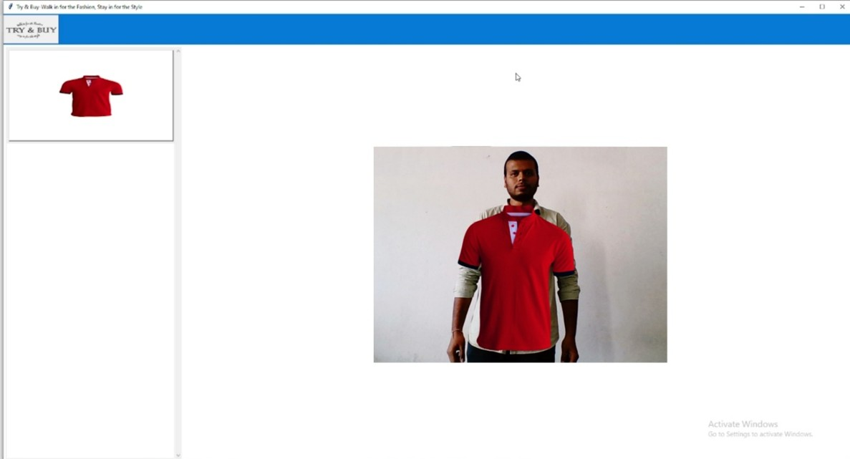
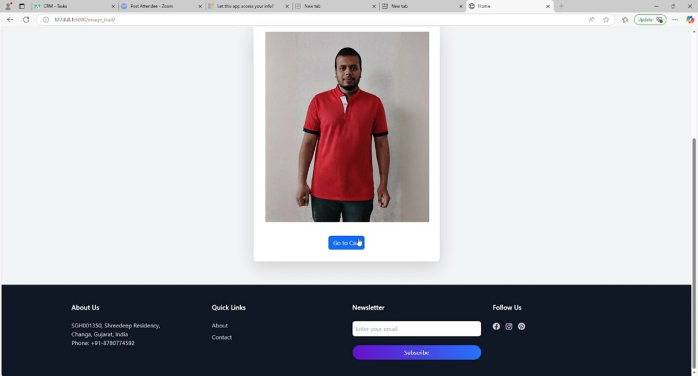
Sample outputs

Slide 25
Challenges
Challenges
Lack of Physical Touch → Users can’t feel fabric texture or fit before buying.
Technical Limitations → Accuracy depends on camera quality and lighting conditions.
Poor Execution → Some systems misalign garments, making the try-on experience unreliable.
Limited Product Availability → Not all brands or clothing types support virtual try-ons.
Data Privacy Concerns → Users worry about how their images and data are stored and used.

Slide 26
Future Improvements
Future Improvements
Better Fitting Accuracy → Use AI models to improve garment alignment.
AR/VR Integration → Implement 3D body scanning for a more realistic trial experience.
Expanded Product Range → Support footwear, accessories, and various body types.
AI-Based Personalization → Recommend outfits based on user preferences.
Improved Data Privacy → Strengthen security to protect user images and data.

Slide 27


